Slide 1




TVT Cloud Platform
Portal & Installer APP
0800 267 246 / www.csproducts.co.nz

Slide 2
TVT CCTV
This is a CLOUD PC/Installer App for installers to provide a remote service for all their customers all in one platform.

Slide 3
TVT CCTV
Initial Account Setup
Installer: SuperLive Installer
Setup PC cloud account
  Contact CSP to setup and Installer Account – an email will be sent to the installer with a link to complete the online form setup an account.
  If required, use link to confirm and test your account login.
  https://bus-partner20.svcldap.com/ - /login
Setup Installer App
  Please download SuperLive Installer App on Playstore/Appstore ( Currently not available )
  Login with Installer email and password used in Cloud Account
  A verification code will be sent to installer’s email address.

Slide 4
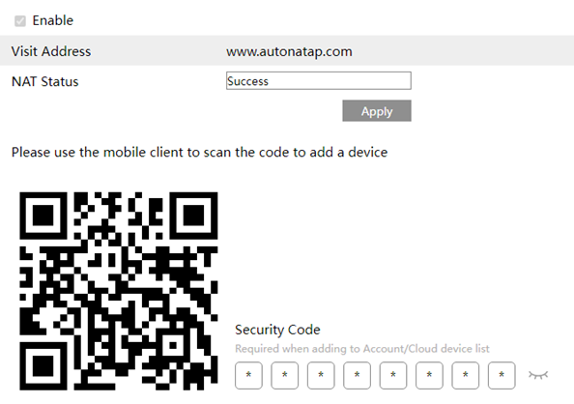
TVT CCTV
End User Setup
End User: Supercam Plus
End User App
Please download SuperCam Plus on Playstore/Appstore
Setup end user account on App
Add Site to app via QR code and use the Security Code next to QR code.
Test Site Connection once site is
added

Slide 5
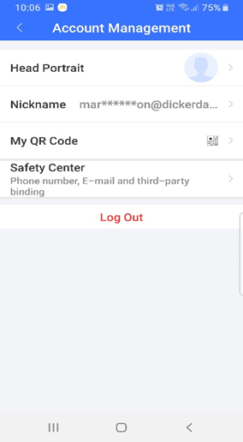
TVT CCTV
End User Setup
Go to Account Management on App and select My QR Code

Slide 6
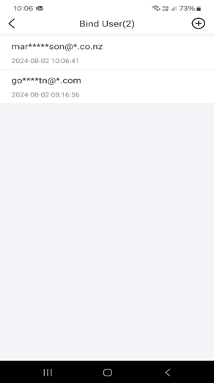
TVT CCTV
Installer App
Installer App: SuperLive Installer
On installer App, go to Profile and select Bind User and then select the Add Icon +.
Scan the QR code on the End User App
• One added, the User’s email will appear on the Installer App.

Slide 7
TVT CCTV
Installer App
Installer App: SuperLive Installer
On installer App, go to Profile and select Bind User and then select the Add Icon +.
Scan the QR code on the End User App
• One added, the User’s email will appear on the Installer App.

Slide 8
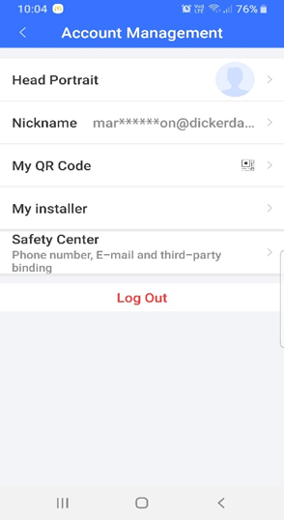
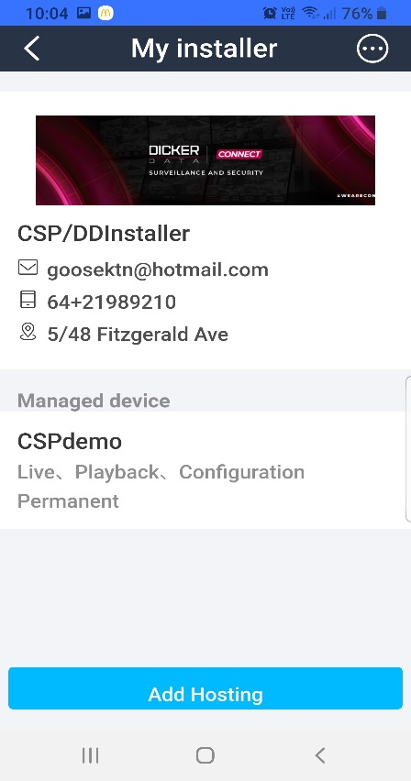
TVT CCTV
End User App
End User App: SuperCam Plus
Go to Account Management and a new line will appear My Installer.
    Select My Installer and then select Add Hosting.

Slide 9
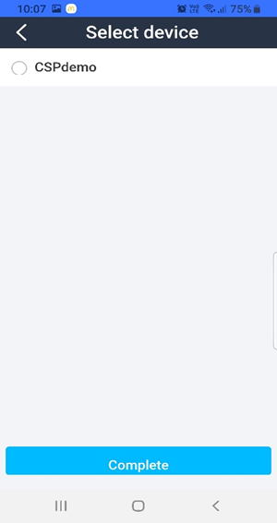
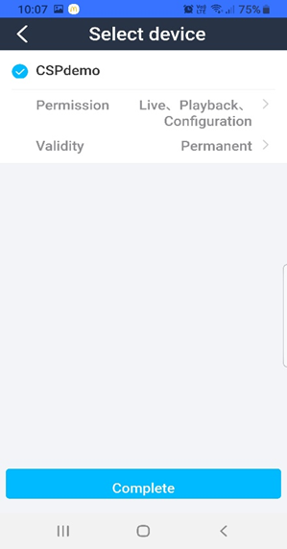
TVT CCTV
End User App
Select the device you want to Add and then what Permissions and Validity options you want to use, then select complete

Slide 10
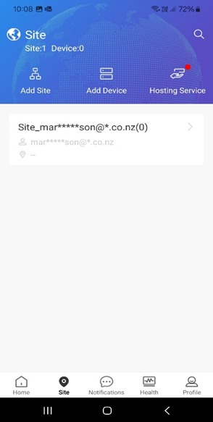
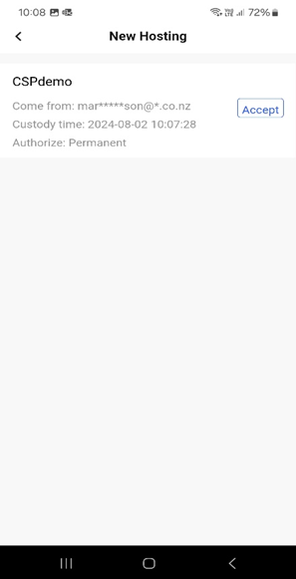
TVT CCTV
Installer App
On installer App go to Site and Hosting Service, New Hosting and select Accept
• The Site has now been added to the installer Account for the Installer App and PC Cloud Platform.

Slide 11
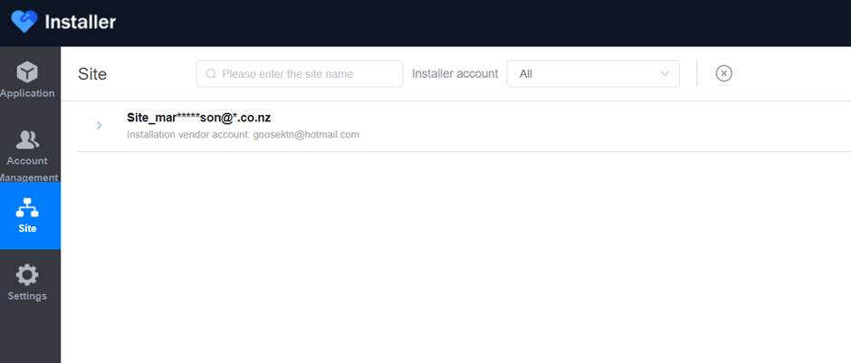
TVT CCTV
PC Cloud Platform
Installer: PC Cloud Platform
Log in to https://bus-partner20.svcldap.com/ - /login and go to Site.
A list of all you customers will now be on screen.
To select a customer select the Arrow ( on the left )

Slide 12
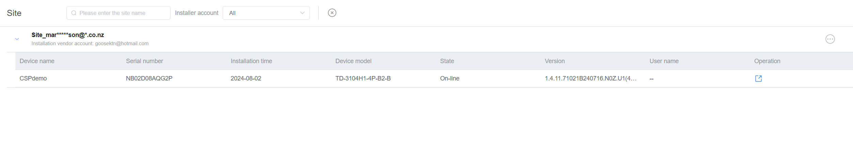
TVT CCTV
PC Cloud Platform
Select the Operation symbol on the righthand side to the Web browser link of the site.
This will connect directly to the NVR system with admin access to your customers’ site.

Slide 13

Congratulations!

