Slide 1


Bosch 3000 B228 expander setup
connect.dickerdata.co.nz

Slide 2
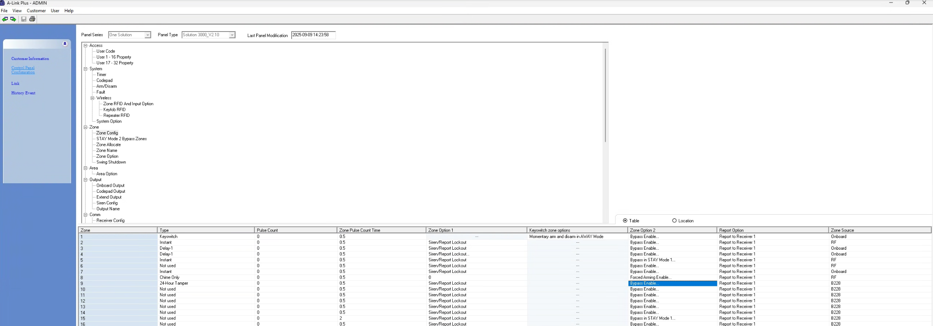
B228 setup
The B228 expander to a Bosch 3000. The B228 expander is addressed 1, for zones 9 – 16, reassign the zones from the panel to use the expander zones B228. This can be done with A-Link Plus software or via Keypad programming.
Control Panel Configuration – Zone Config – Zone Source Bosch ALink Plus Update 6.1.21

Slide 3
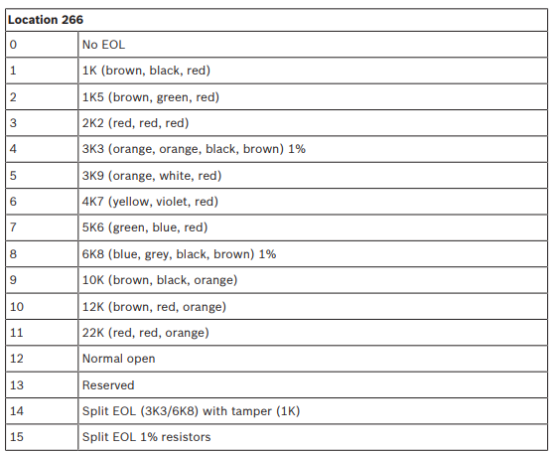
B228 setup
Change EOL zone options from Split zone config (15) to one of the Single EOL options (1 -11)

Slide 4
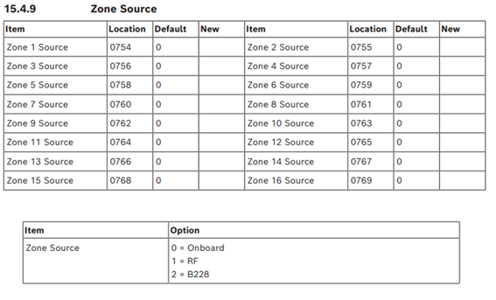
B228 setup
Zone Source – From these locations you can assign the zones 9 -16 to the B228 expander.

Slide 5
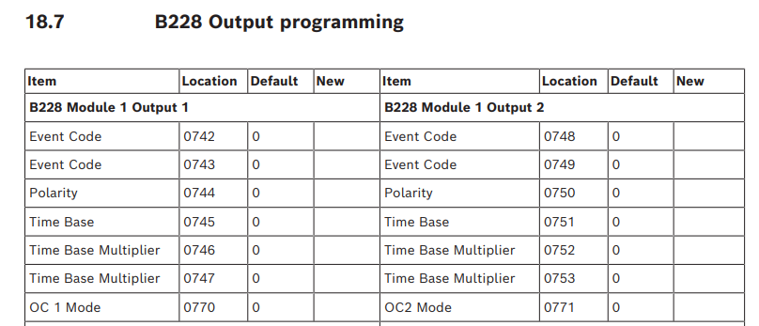
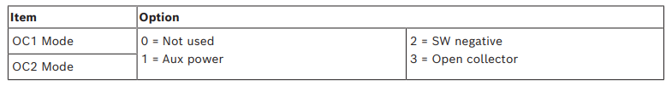
B228 setup
Zone Source – From these locations you can assign the zones 9 -16 to the B228 expander.

